Slide 1
Convertible bond pricing model
資管所 蘇柏屹
指導老師 戴天時

Slide 2
Agenda
Introduction
Credit risk model
Convertible bond pricing model
Our convertible bond pricing model

Slide 3
Introduction
Convertible bond is a hybrid attributes of both fixed-income securities and equity
In specific period, convertible bond can be converted into equity with predetermined convert ratio
Convertible bonds have call features, which provide the issuer a way to force conversion or redemption of the bonds

Slide 4
Credit risk model
Firm value model (Merton,1974)
  Credit risk is considered equity as call option on firm's assets
First passage time model (Black & Cox ,1976)
  Solve the problem of premature bankruptcy
Intensity Model (Jarrow & Turnbull ,1995)
  Use an arbitrage-free bankruptcy process that triggers default

Slide 5
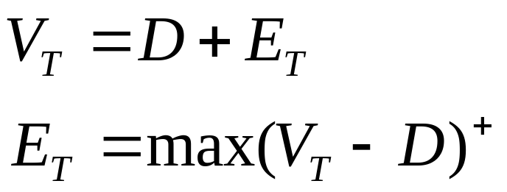
Firm value model (Structure model)
Assume
  Firm has only one class of bond that has no coupon payment and the risk-free interest rate is constant
  Bankruptcy is triggered at the maturity and the cost for bankruptcy is zero

Slide 6
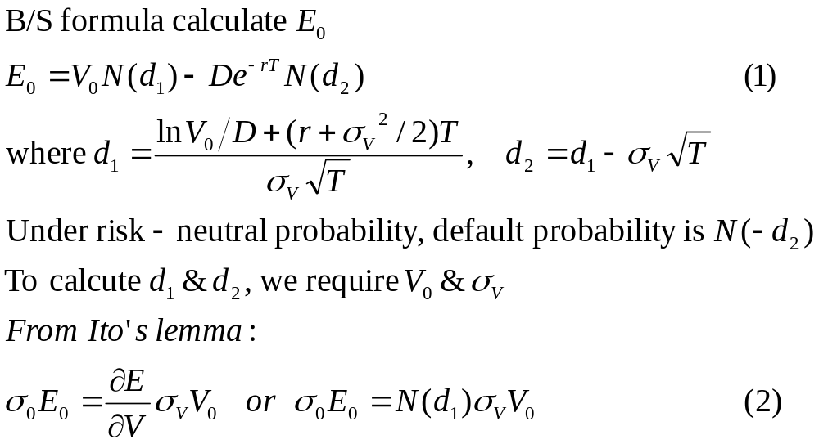
Firm value model (Structure model)

Slide 7
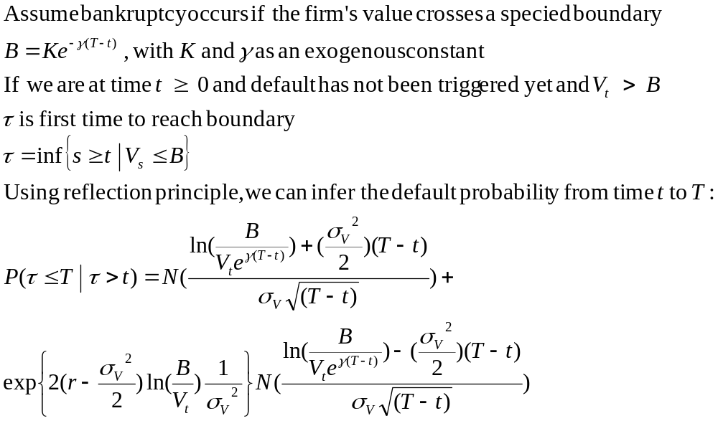
First passage time model

Slide 8
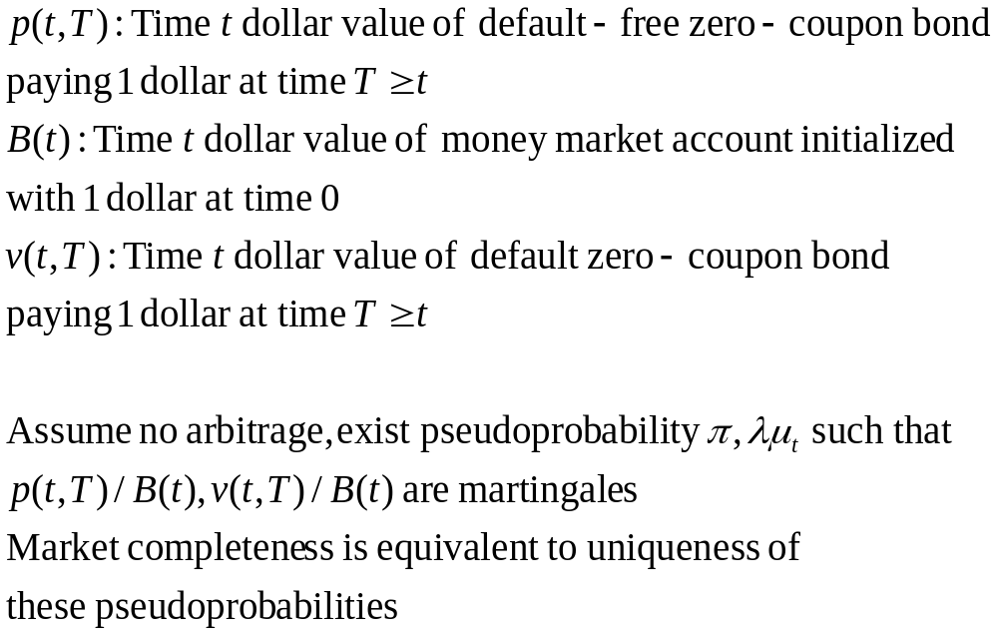
Intensity Model

Slide 9
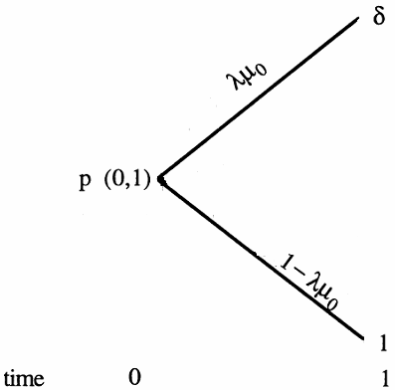
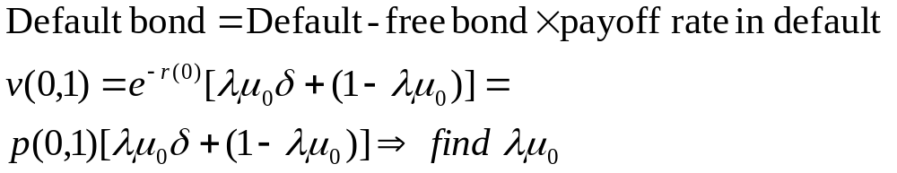
Intensity Model

Slide 10
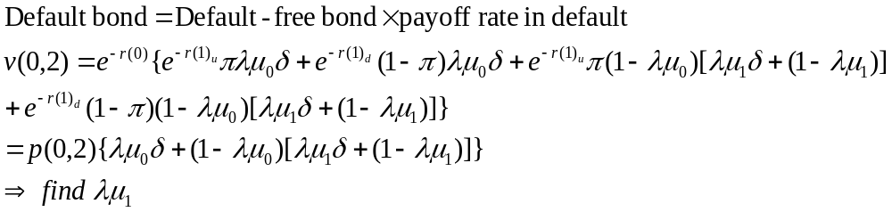
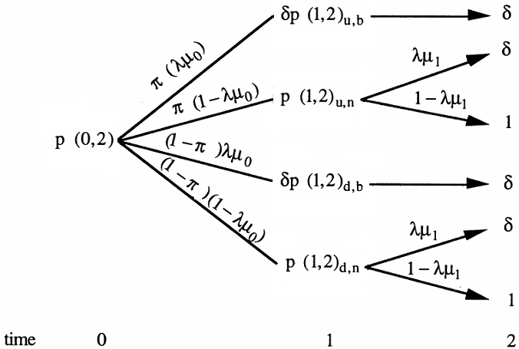
Intensity Model

Slide 11
Paper survey
Structure model: Assume stochastic processes for S&r, and use Ito’s lemma to derive PDE, then exploit boundary condition to solve PDE
  Brenen & Schwartz(1977)
  Brenen & Schwartz(1980)
Reduce model: Use tree model to simulate S&r, and calculate each node price then rollback
  Hung & Wang(2002)
  Chambers & Lu(2007)

Slide 12
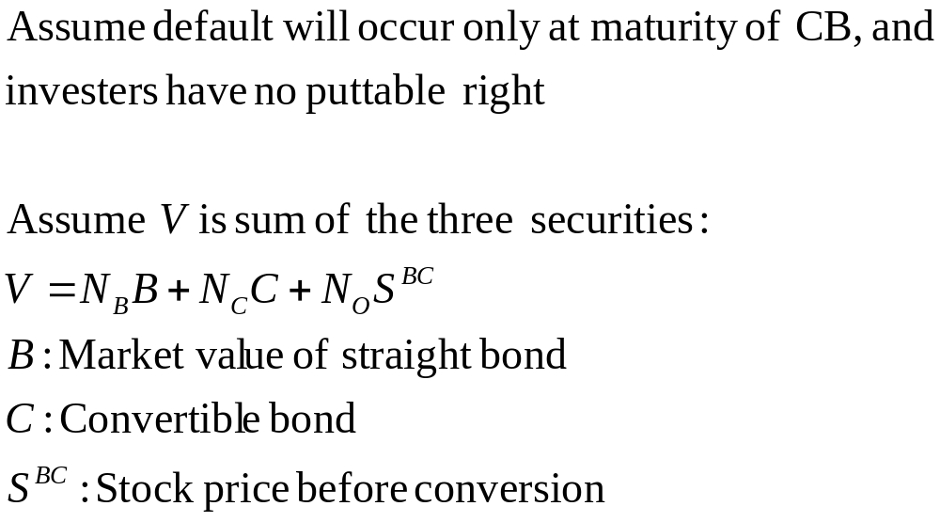
Brenen & Schwartz(1980)

Slide 13
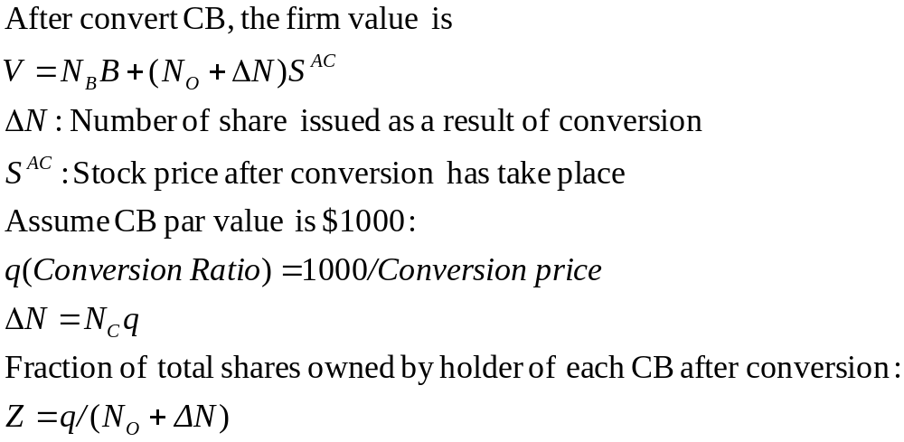

Brenen & Schwartz(1980)

Slide 14
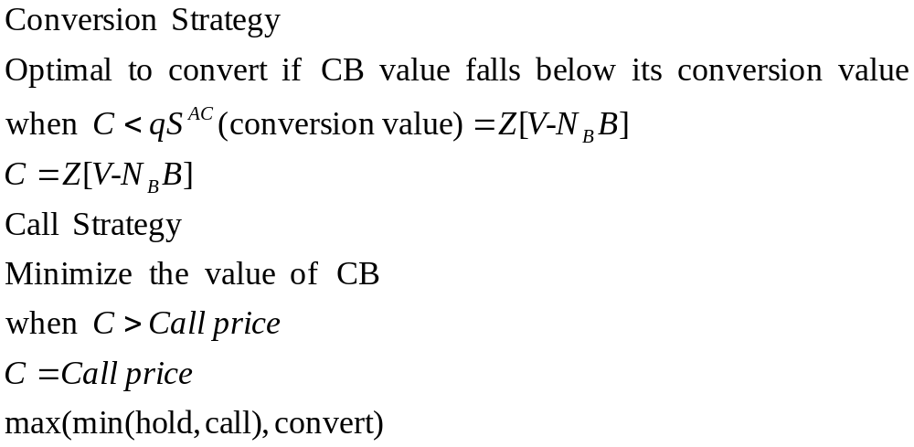
Call & conversion strategy

Slide 15
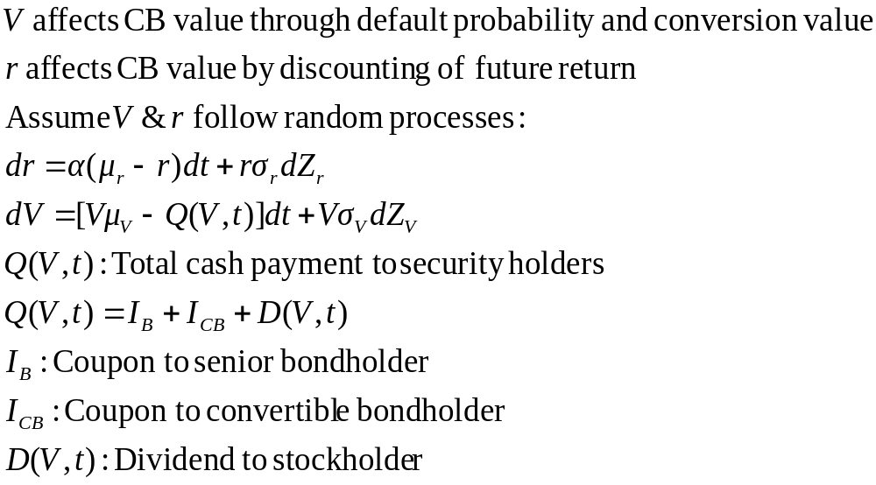
Random process

Slide 16
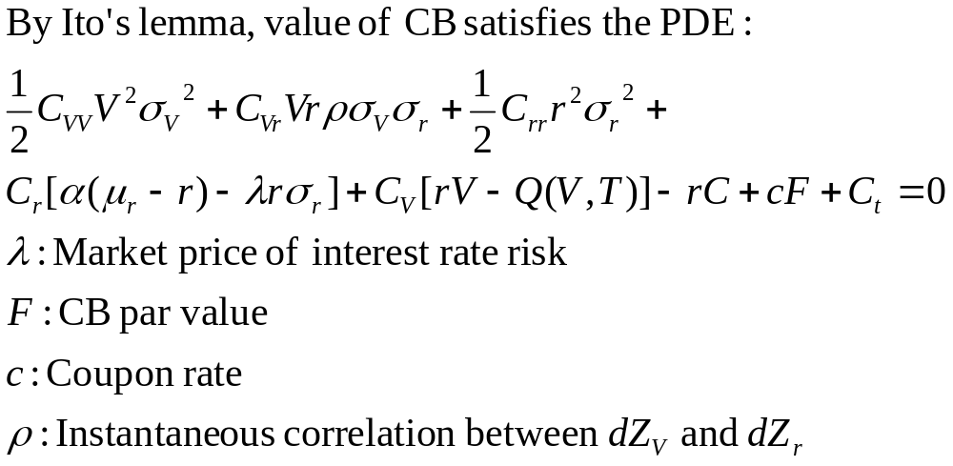
CB’s PDE

Slide 17
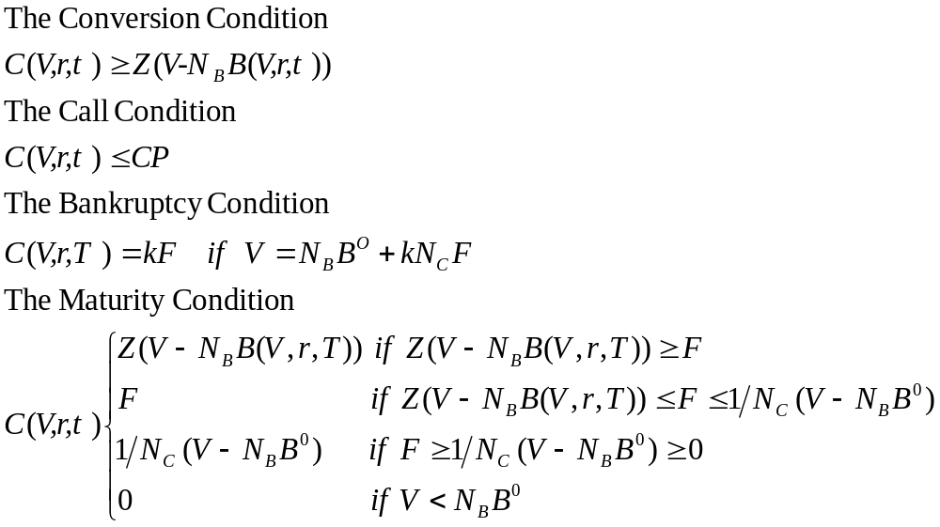
Boundary condition

Slide 18
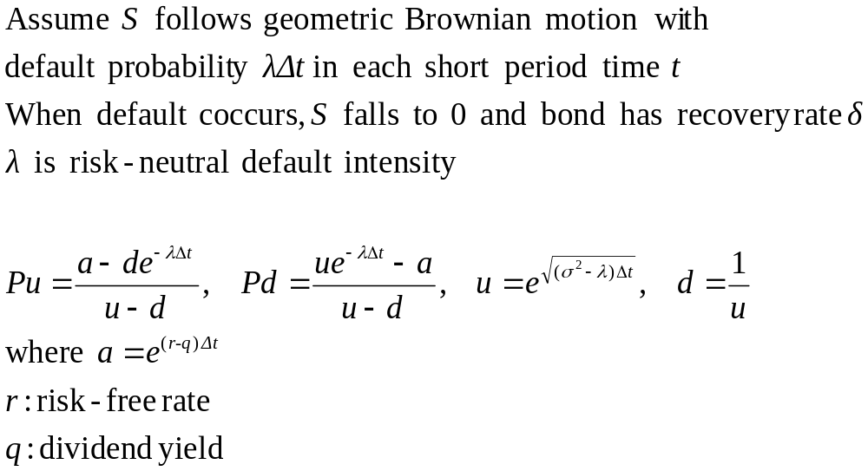
Reduce model (simple)

Slide 19
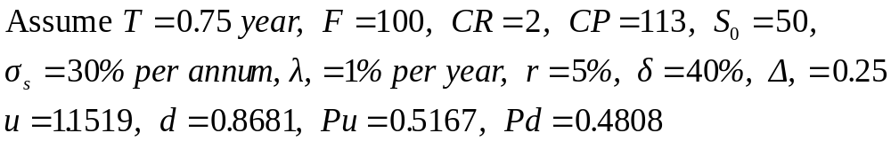
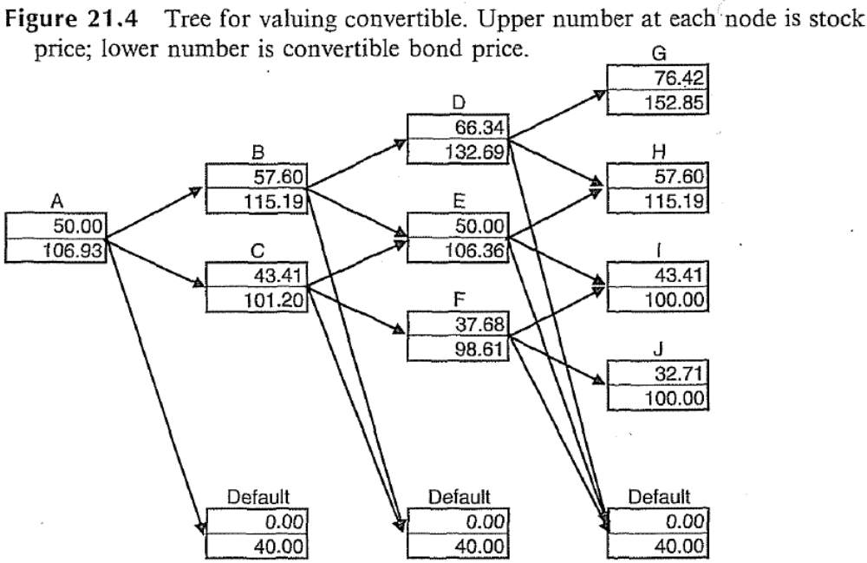
Reduce model (simple)

Slide 20
Reduce model
S | Cox-Ross-Rubinstein (CRR model)
r | Ho-Lee lognormal model
λ | Jarrow & Turnbull Intensity Model
S & r without correction | Hung & Wang two factor model
S & r with correction | Das & Sundaram two factor model

Slide 21
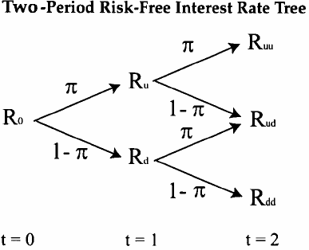
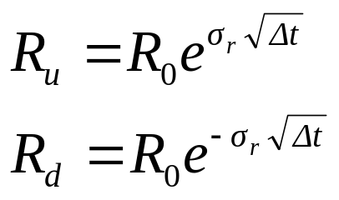
Ho-Lee(1986) lognormal model

Slide 22
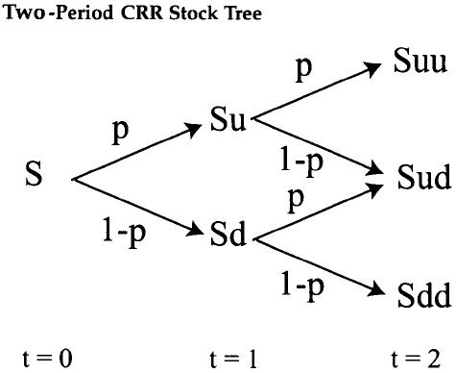
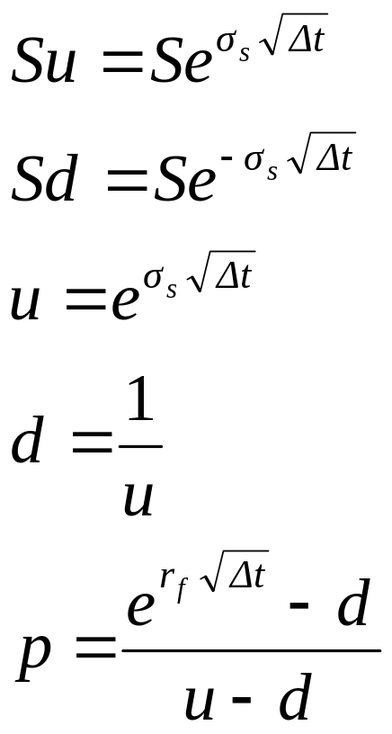
CRR model

Slide 23
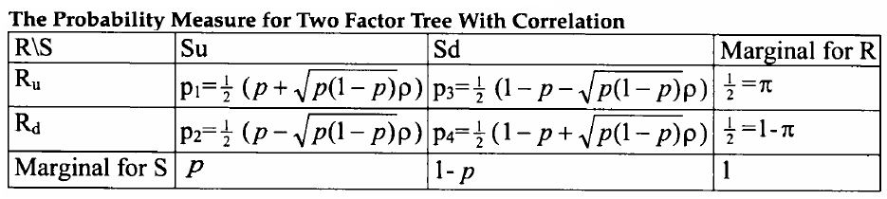
Two factor tree with correction
R_{u},Su
p₁
p₂
R_{d},Su
R,S
p₃
p₄
R_{u},Sd
R_{d},Sd

Slide 24
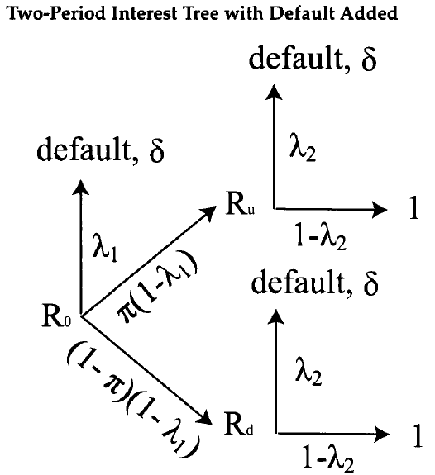
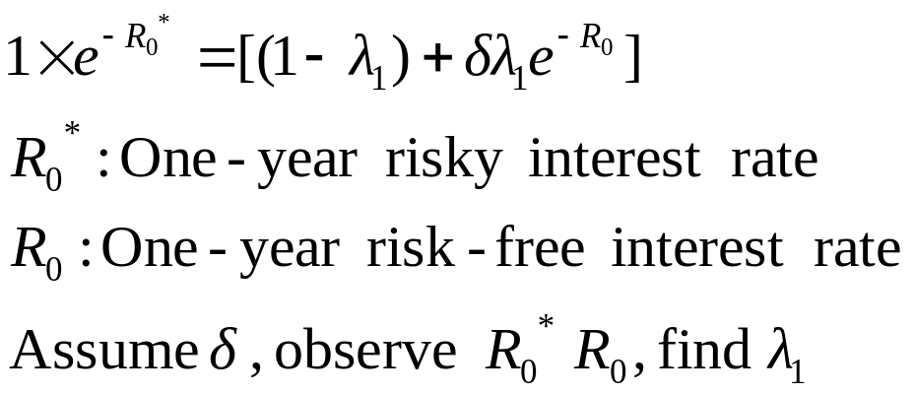
Jarrow & Turnbull Intensity Model

Slide 25
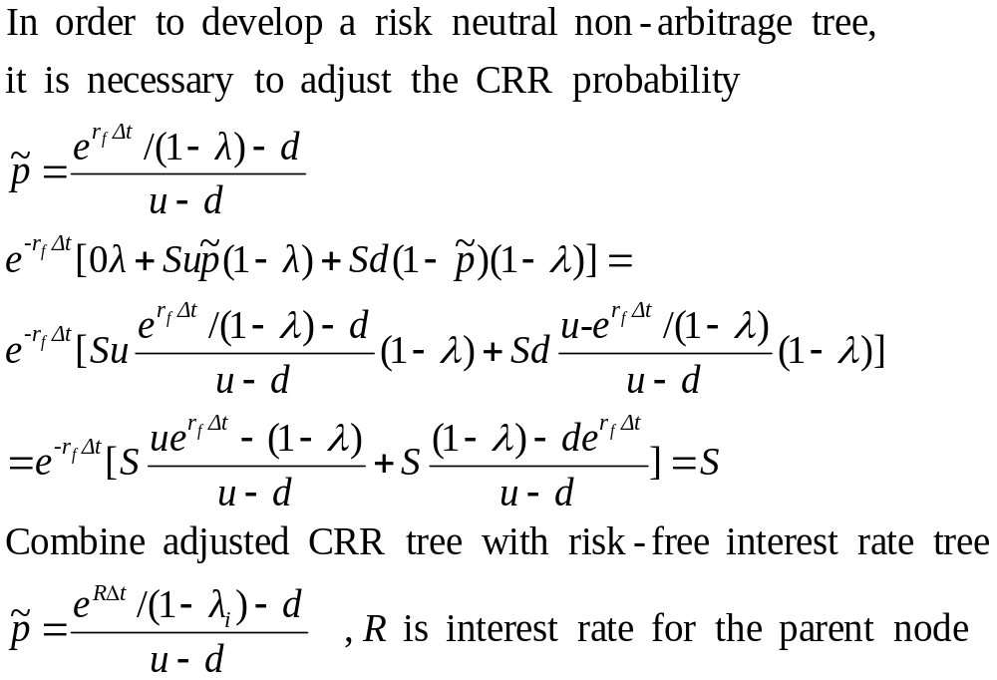
Adjust CRR probability

Slide 26
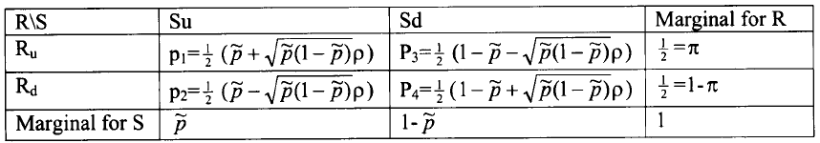
Reduce model (Chamber & Lu)
R_{u},Su
p₁(1-λ_{i})
p₂(1-λ_{i})
R_{d},Su
R,S
p₃ (1-λ_{i})
R_{u},Sd
p₄ (1-λ_{i})
λ_{i}
R_{d},Sd
δ

Slide 27
Our pricing model
Improve default probability which is unrelated to stock price
Improve default only occur in maturity date
Structure model + down & out barrier option + FPM + KMV

Slide 28
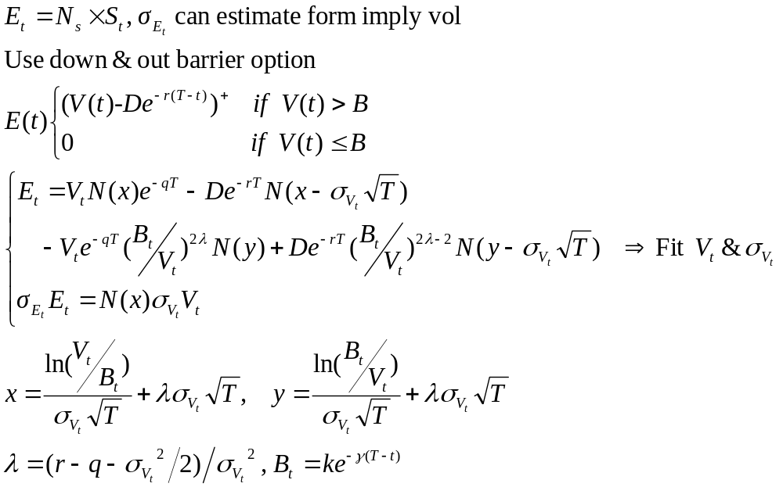
Structure model + down & out barrier option

Slide 29
First Passage Model+KMV
V_{u}
S_{u}
V
S
S_{d}
V_{d}
λ^{S(t)}
Default boundary=Ke^{-γ(T-t)}
Default boundary=Ke^{-γ(T-t)}
K➔1/2 long debt+ short debt (KMV), γ➔ r

Slide 30

Default probability
Assume V ~Lognormal distribution
σ_{v}
The log-normal distribution has PDF
Default boundary=Ke^{-γ(T-t)}
Default probability
V(t)

Slide 31
Further work
The default boundary is given exogenously
Use market CB to look for imply boundary

